Slide 1
Complexity Theory and Computability
Code Hub Meetup! #19
Hannes Kuchelmeister
Attribution-ShareAlike 4.0 International (CC BY-SA 4.0)

Slide 2

Disclaimer: Tip of the Iceberg
Notes:
Both Topics go:
much deeper
more formal and mathematical

Slide 3

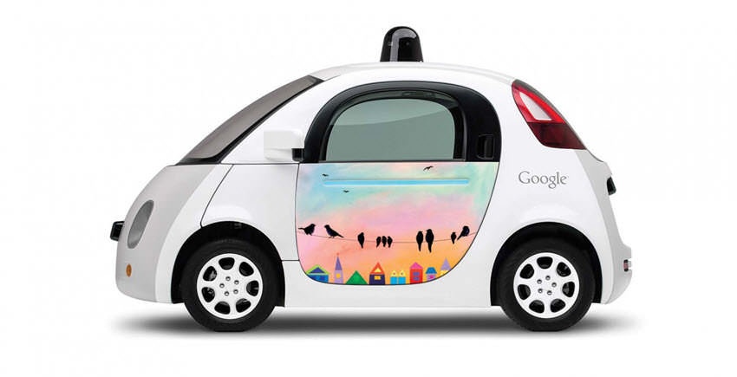
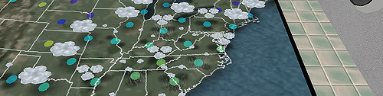
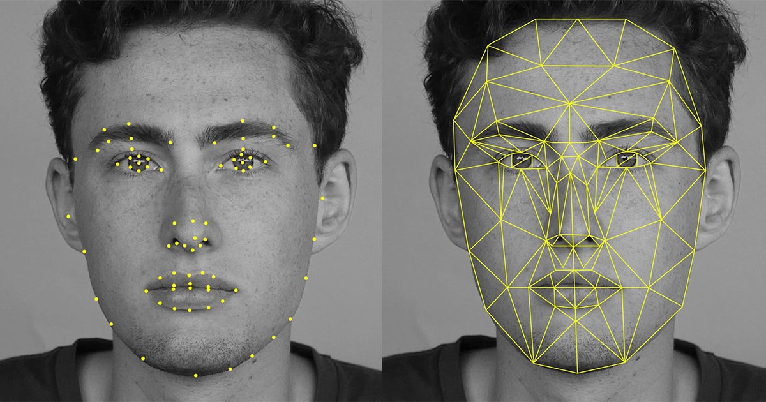
Computability Theory
"Dieses Foto" von Unbekannter Autor ist lizenziert gemäß CC BY-NC-SA
"Dieses Foto" von Unbekannter Autor ist lizenziert gemäß CC BY-NC-ND
"Dieses Foto" von Unbekannter Autor ist lizenziert gemäß CC BY-SA
"Dieses Foto" von Unbekannter Autor ist lizenziert gemäß CC BY-SA
"Dieses Foto" von Unbekannter Autor ist lizenziert gemäß CC BY-SA
Notes:
Computers can:
Recognize Faces
Predict the Weather
Drive Cars (Soon)
Everything?

Slide 4



Halting Problem
Notes:
Suppose we have a program, is this program given an input ever going to HALT
We have a PROGRAM and an INPUT
Is the PROGRAM going to HALT on the INPUT?
Impossible to solve

Slide 5

Halting Problem – Proof by contradiction
Assumption
"Dieses Foto" von Unbekannter Autor ist lizenziert gemäß CC BY-SA
Notes:
How are we going to prove it?
Proof by contradiction.
How does it work?
Make an assumption
Show it leads to contradiction
Therefore assumption must be wrong

Slide 6
Halting Problem – Proof – Assumption
Input
Output
H
Halts
or
Does not Halt
Notes:
Our assumption:
We have a program/machine that:
Says if program will halt
given the input

Slide 7

Halting Problem – Proof
H*
H
Halts
or
Does not Halt
"Dieses Foto" von Unbekannter Autor ist lizenziert gemäß CC BY-SA
Notes:
Construct other machine/program H*
Uses H but gives H
a program
Give program itself as input
If H says program
is going to HALT our machine will go in endless loop
If NOT going to HALT our machine will HALT

Slide 8
Into Itself
H*
H*
H
Halts
H*
or
Does not Halt
H*
"Dieses Foto" von Unbekannter Autor ist lizenziert gemäß CC BY-SA
Notes:
So what happens now when we put H* into H

Slide 9
Into Itself
H*
H*
H
Halts
H*
or
Does not Halt
H*
"Dieses Foto" von Unbekannter Autor ist lizenziert gemäß CC BY-SA
Notes:
So what happens now when we put H* into H
First possibility: H says H* HALTS

Slide 10
Into Itself
H*
H*
H
Halts
H*
or
Does not Halt
H*
"Dieses Foto" von Unbekannter Autor ist lizenziert gemäß CC BY-SA
Notes:
So what happens now when we put H* into H
First possibility: H says H* HALTS
But if H says that, H* enters into a endless loop -> meaning it does not HALT
Contradiction

Slide 11
Into Itself
H*
H*
H
Halts
H*
or
Does not Halt
H*
"Dieses Foto" von Unbekannter Autor ist lizenziert gemäß CC BY-SA
Notes:
So what happens now when we put H* into H
Either H says H* HALTS
But if H says that, H* enters into a endless loop -> doesn’t HALT
Contradiction
Alternatively: H says H* does NOT HALT
this means H* will immediately HALT
but this contradicts H

Slide 12
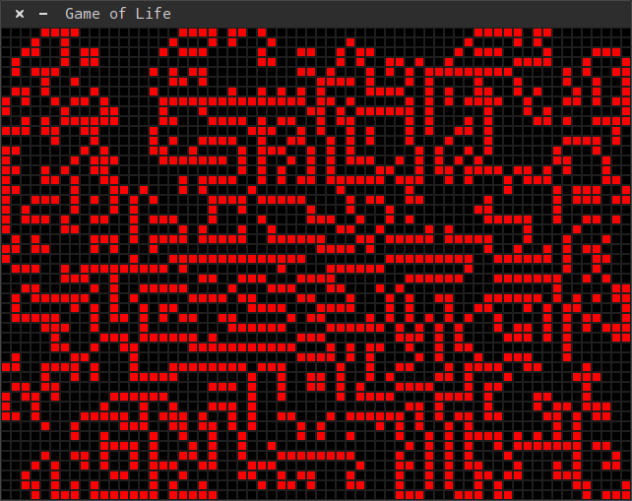


Other undecidable Problems
Air Travel Planning [1][2]
Multiply set of Matrices to yield the zero matrix
Hilbert’s tenth problem
Conway’s Game of Life
Busy Beaver Champion
"Dieses Foto" von Unbekannter Autor ist lizenziert gemäß CC BY-SA
"Dieses Foto" von Unbekannter Autor ist lizenziert gemäß CC BY-SA
Notes:
Air Travel Planning
Given the airlines airfare constraints
Good solutions that have a good search radius
Cheapest fare can never be guaranteed
Multiply set of Matrices to yield the zero matrix
Given a set of matrices, can you multiply them to get the zero matrix
(usage of one matrix multiple times is allowed)
Hilbert’s tenth problem
Does a polynomial equation (usually more than two variables) have an Integer solution?
Conway’s Game of Life
Given two states initial and searched
Will the State searched appear later on
Busy Beaver Champion
Is the given touring machine a busy beaver champion

Slide 13
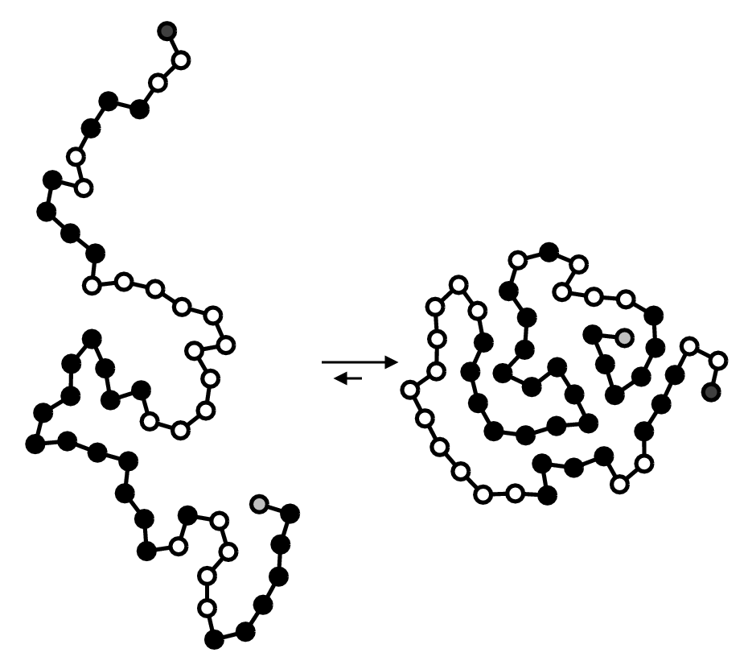
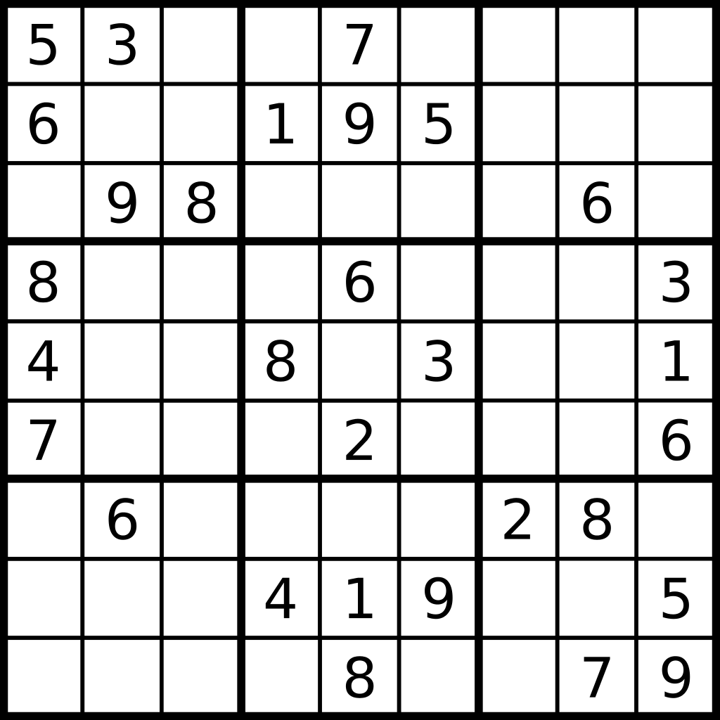
Complexity Theory
What does Protein Folding and Solving a Sudoku have in common?
"Dieses Foto" von Unbekannter Autor ist lizenziert gemäß CC BY-SA
"Dieses Foto" von Unbekannter Autor ist lizenziert gemäß CC BY-SA
Notes:
What does Protein Folding and Solving a Sudoku have in common?

Slide 14

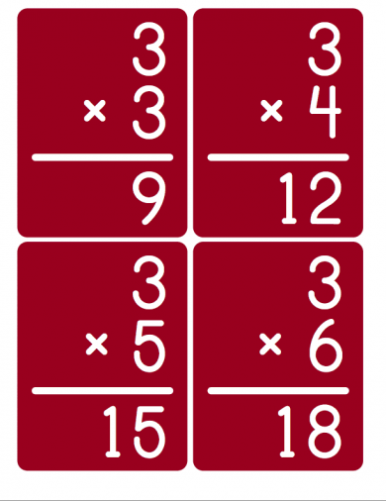
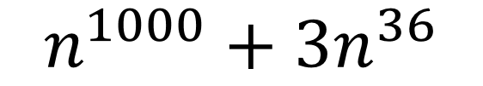
Complexity Class P - Easy Problems
"Dieses Foto" von Unbekannter Autor ist lizenziert gemäß CC BY-NC-ND
"Dieses Foto" von Unbekannter Autor ist lizenziert gemäß CC BY-NC
Notes:
In complexity theory: Complexity Classes (categorize problems in how efficient to solve)
look at TWO in this presentation.
Class P (easy problems)
Multiplication
Sorting
Everything that can be answered in Polynomial time
Can be still too slow to be practical.

Slide 15
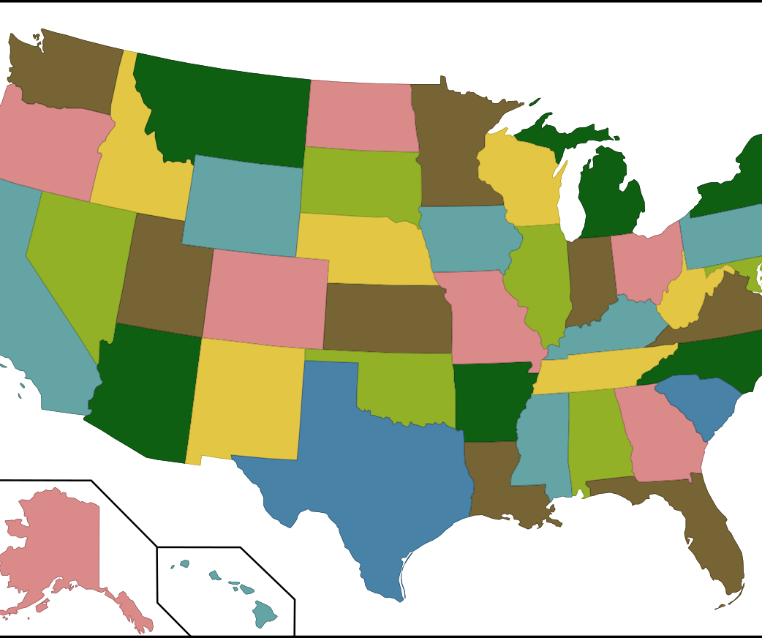

Complexity Class NP – Easy to Check
"Dieses Foto" von Unbekannter Autor ist lizenziert gemäß CC BY-SA
Notes:
Puzzle
Map/Graph Colouring
Sudoku
Protein Folding
NP = (Nondeterministic polynomial time)
Given a solution: polynomial time to verify

Slide 16
P versus NP
Is recognizing a solution to a problem quickly mean that it is possible to quickly find it?
Notes:
Arguably biggest unsolved question in complexity theory
Millennium price problem (Clay Mathematics Institute; 1 million dollars)
Fast to verify problems =? fast to solve

Slide 17
Proving NP-completeness
Show it is in NP
  Verify Solution
Show it is NP-hard
  Reduction
Notes:
In NP
Verify solution in polynomial time
NP-hard
Reduce other problem in polynomial time to it

Slide 18

Example – Proof Knapsack
Cost Threshold C
Maximum Weight Capacity W
6€
4€
5€
6€
3€
Notes:
As Optimization problem:
Fill Backpack to be most valuable
As decision problem:
Is there a combination of items that reaches the cost threshold C?

Slide 19
Show it is in NP – Solution checking is fast
4€
6€
3€
Cost Threshold: 10€
Notes:
Question: Is there a combination of items that is higher than 10€ that fits in the backpack.
Given a Solution how do we check it? -> NEXT SLIDE

Slide 20

Show it is in NP – Solution checking is fast
6€
4€
3€
+
Cost Threshold: 10€
Notes:
Checking in linear time:
Does it Fit? -> Add up all sizes -> NEXT

Slide 21

Show it is in NP – Solution checking is fast
6€
4€
3€
+
Cost Threshold: 10€
$$≤$$
13€
Notes:
Does it pass the cost threshold? -> Add up all costs
Two checks per item -> Complexity 2*n
Now we have shown: It is in NP

Slide 22
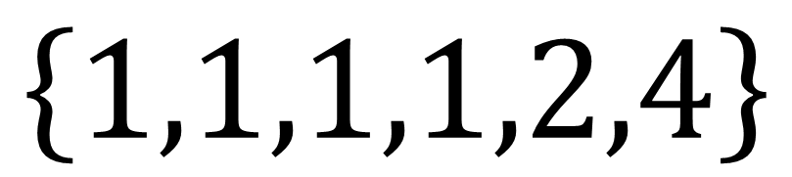
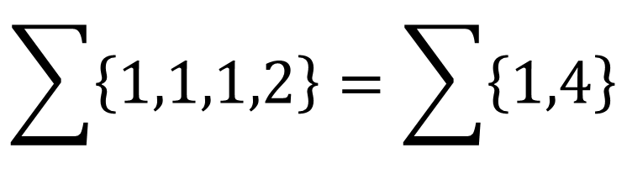
Show it is NP-hard
Reduce NP-complete problem to Knapsack
Partition Problem
$$\left\{1,1,1,1,2,4\right\}$$
$$\sum{\left\{1,1,1,2\right\}}=\sum{\left\{1,4\right\}}$$
Notes:
Now show it is NP-hard
We need another problem which we can reduce to Knapsack
Partition problem
Given a list of numbers
Is it possible to divide them into two separate lists so that the sum of the elements are the same for both

Slide 23
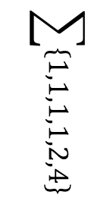
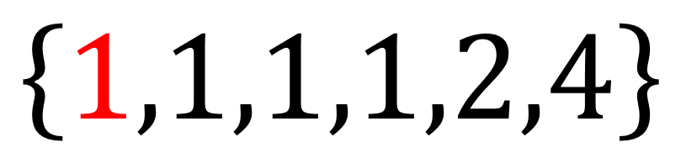
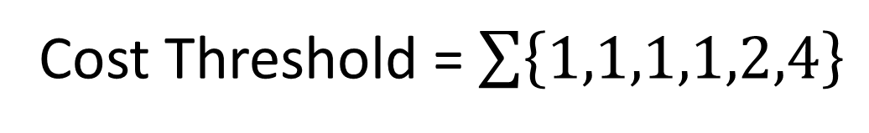


Show it is NP-hard
$$\left\{1,1,1,1,2,4\right\}$$
$$\sum{\left\{1,1,1,1,2,4\right\}}$$
$$2×1$$
$$2×1$$
Cost Threshold = $\sum{\left\{1,1,1,1,2,4\right\}}$
Notes:
Double each elements size
Set cost threshold and capacity of backpack to the same

Slide 24




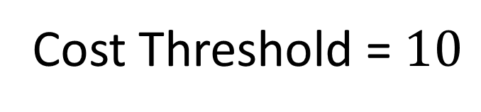


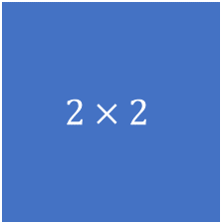
Show it is NP-hard
$$\left\{1,1,1,1,2,4\right\}$$
$$2×2$$
$$2×4$$
Capacity = 10
$$2×1$$
$$2×1$$
$$2×1$$
$$2×1$$
$$2×1$$
+
Cost Threshold = $10$
10€
10€
Notes:
Basically double each elements size
Set cost threshold and capacity of backpack to the same.
Cost Threshold ensures greater or equal than
Weight capacity ensures smaller or equal than
This means it has to be exactly the sum of the group

Slide 25


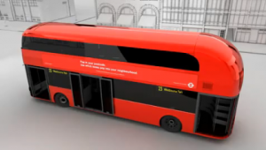
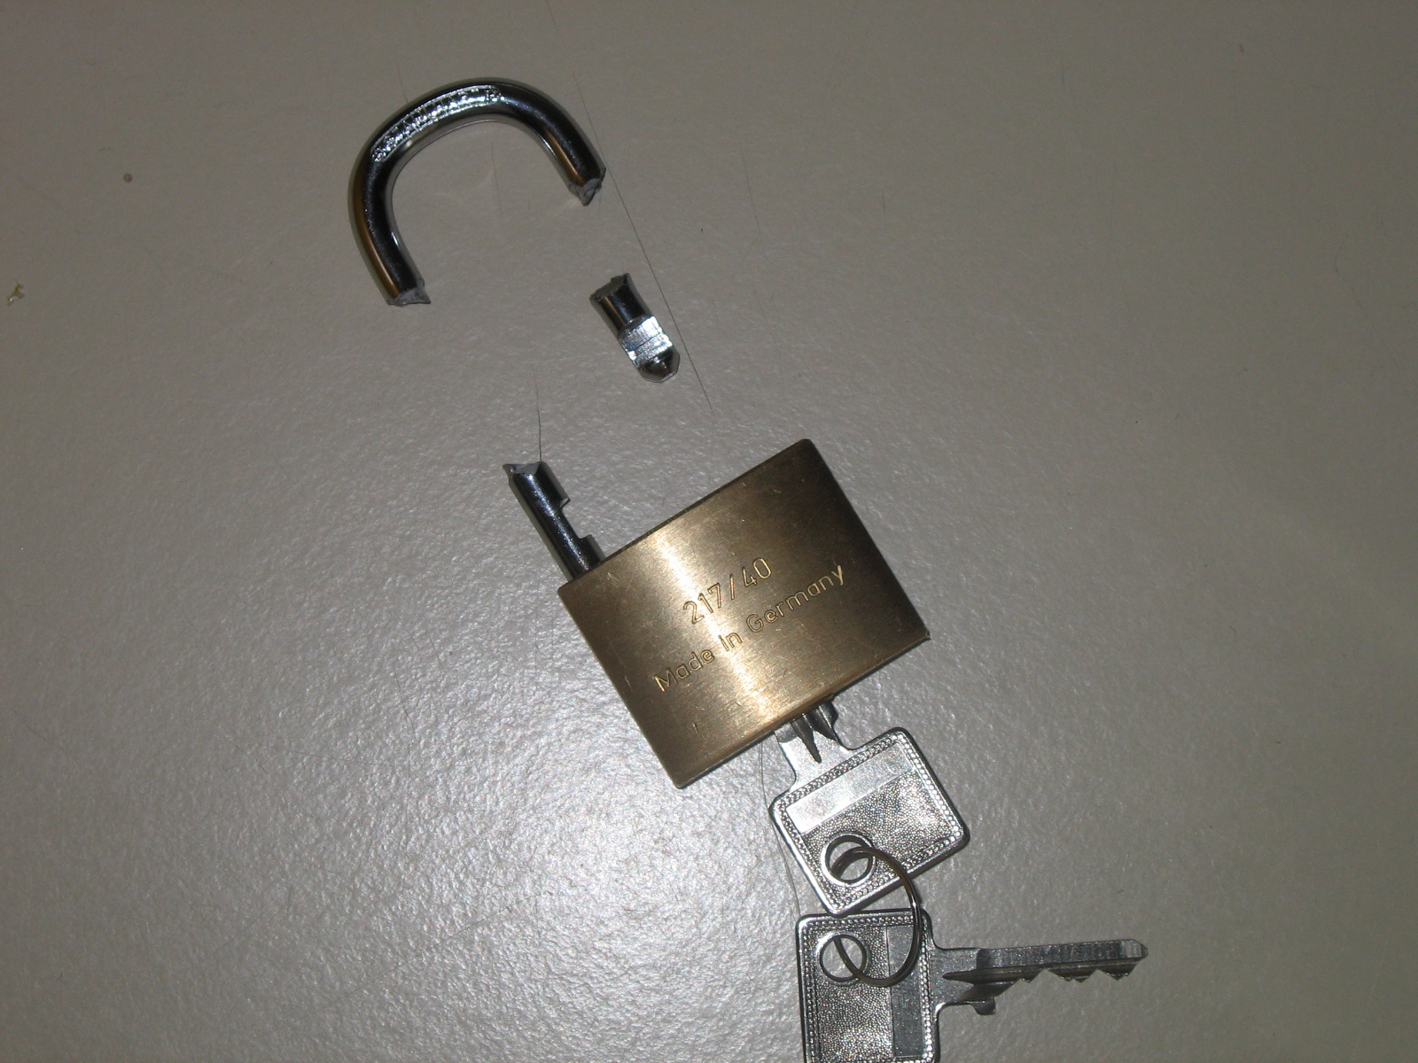
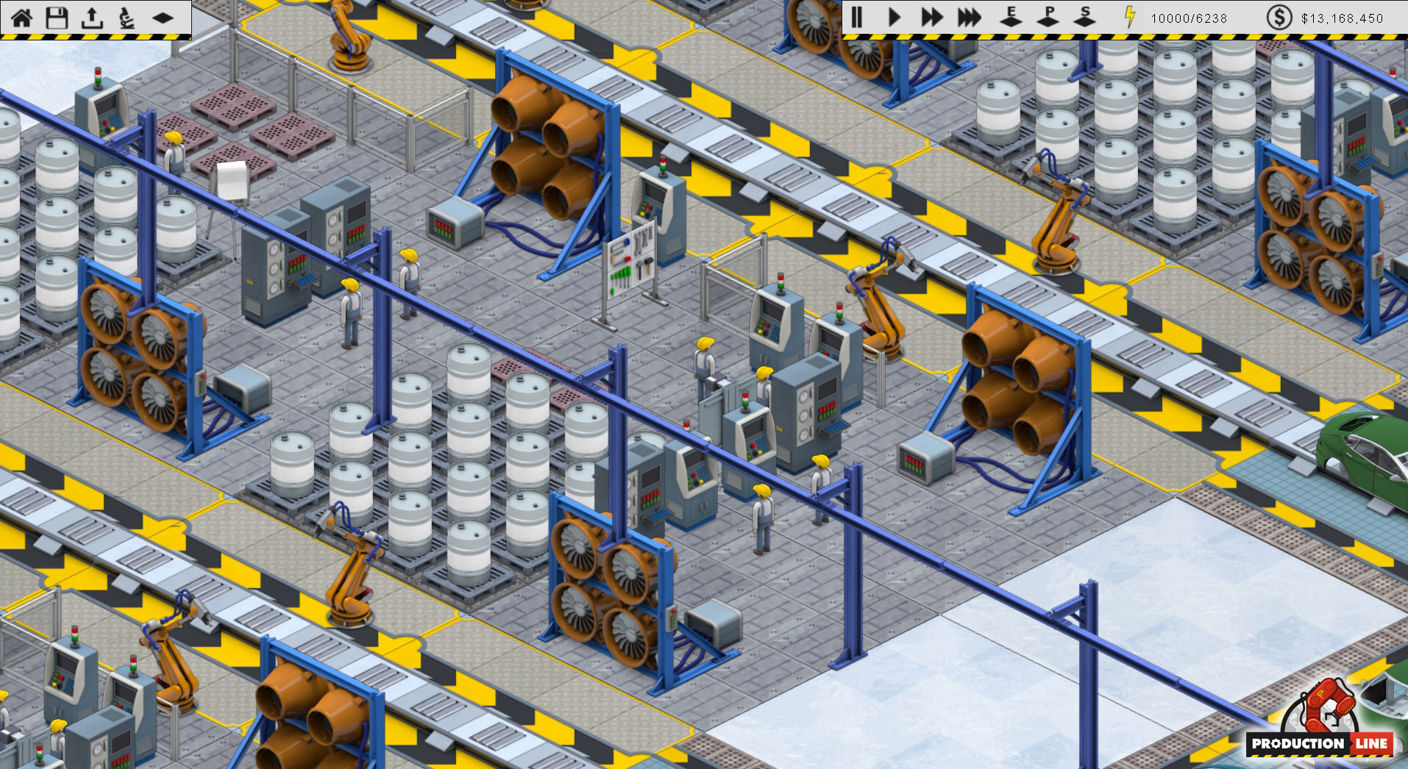
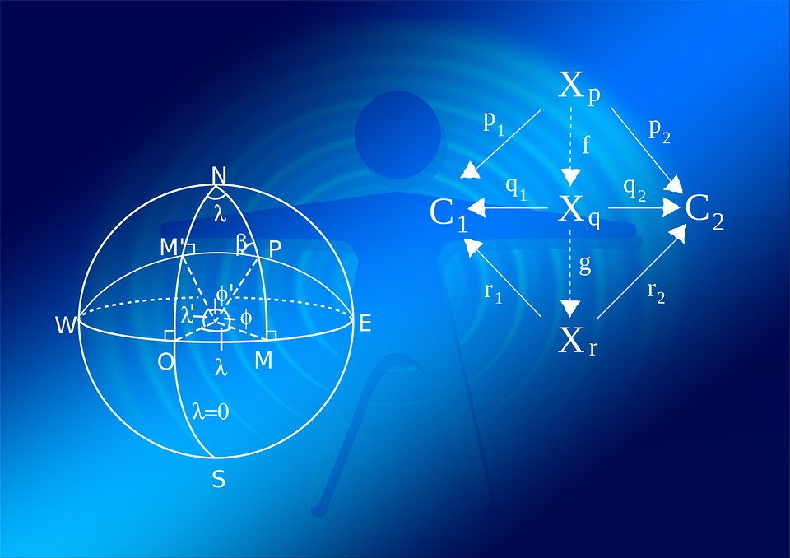
Implication P = NP
"Dieses Foto" von Unbekannter Autor ist lizenziert gemäß CC BY-SA
"Dieses Foto" von Unbekannter Autor ist lizenziert gemäß CC BY-SA
"Dieses Foto" von Unbekannter Autor ist lizenziert gemäß CC BY-SA
"Dieses Foto" von Unbekannter Autor ist lizenziert gemäß CC BY-NC-SA
Notes:
Broken Crypto
Advances in Industrial Production (e.g. less waste)
Better cheaper public transport (efficient route planning)
Leaps in Maths (Automatic Proofs)
Dramatic Advances in Medicine (protein folding)
Not automatically -> Non algorithmic proof OR algorithm ($n^{100}$) for practical usage to slow

Slide 26

Conclusion & Recap
Notes:
Computers cannot do EVERYTHING

Slide 27
Conclusion & Recap
Notes:
Computers cannot do EVERYTHING
Certain Problems -> solve one fast -> next slide

Slide 28
Conclusion & Recap
Notes:
Computers cannot do EVERYTHING
Certain Problems -> solve one fast -> solve all fast -> Probably not possible

